Slide 1

Grocery Store Management
PRESENTED BY :
CHAUHAN CHAYAN
BATCH: 450

Slide 2
About me
My name is Chauhan Chayan. I have completed my B’Tech in Information Technology from Silver oak university, Ahmedabda (2021-2025)
I want to learn Data Science because I enjoy finding useful insights from data to help make better decisions. I also like working with numbers and tools to uncover patterns that solve real-world problems.
LinkedIn profile : linkedin
GitHub profile: GitHub

Slide 3
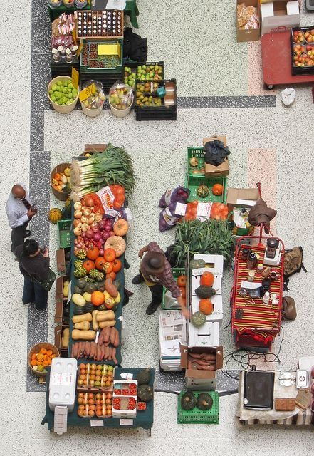
Agenda
Problem Statement
Business Problem
Problem Statement
Objective of the Project
About Tables
ER Diagram and schema explanation
Key analysis questions (use cases)
SQL query results with screenshots or summaries
Final business insights and recommendations
Conclusion
Q&A Slide

Slide 4

Business Problem
Large amount of sales and customer data is generated daily, but without a structured database it is difficult to track revenue and performance.
The store lacks clear insights about top customers, best-selling products, supplier contribution, and employee efficiency.
Due to absence of data-driven analysis, business decisions are not optimized for profitability and operational efficiency.

Slide 5
Problem Statement
Grocery stores generate large amounts of data related to customers, products, suppliers, employees, and orders.
Without a proper database system, it becomes difficult to track sales, inventory, customer behavior, supplier contribution, and employee performance.
This project develops a SQL-based Grocery Store Management System to organize data into a relational database.
SQL queries are used to analyze revenue trends, purchasing patterns, and product performance.
The system supports better decision-making and improves operational efficiency.

Slide 6

Objective of the Project
The main goals of this SQL project are:
To design and implement a SQL-based Grocery Store Management System.
To organize customer, product, supplier, employee, and order data into a relational database.
To enable efficient tracking of sales performance and inventory movement.
To identify top customers and best-selling products.
To extract meaningful business insights such as revenue trends, purchasing patterns, and product performance for better decision-making and operational efficiency.

Slide 7
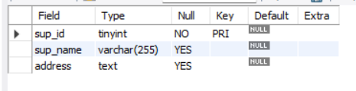
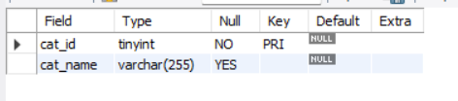
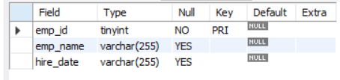
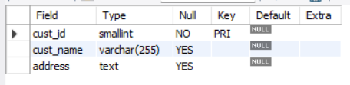
Tables
Supplier Table
Categories Table
Employees Table
Customers Table

Slide 8
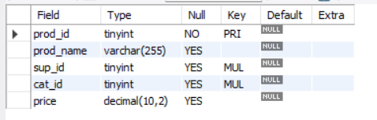
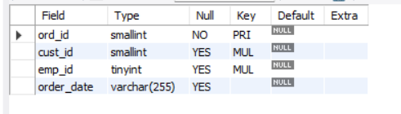
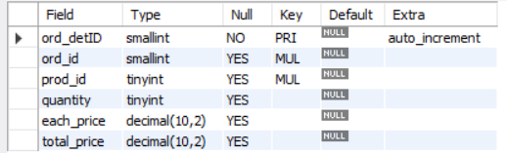
Tables
Products Table
Orders Table
Order_details Table

Slide 9
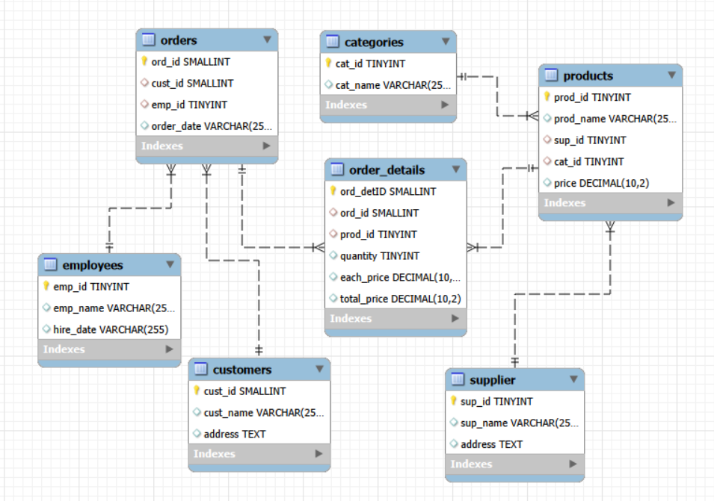
E R diagram

Slide 10
Table Relationships
One-to-Many from supplier to products
One-to-Many from categories to products
One-to-Many from products to order_details
One-to-Many from orders to order_details
One-to-Many from customers to orders
One-to-Many from employees to orders

Slide 11
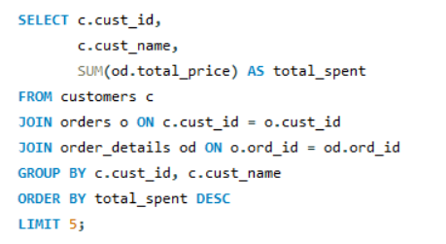
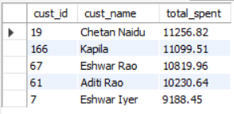


Customer Insights
Who are the top 5 customers by total purchase amount?
How many unique customers have placed orders?

Slide 12
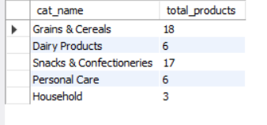
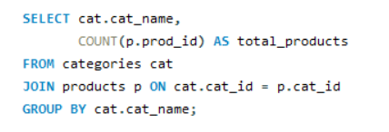
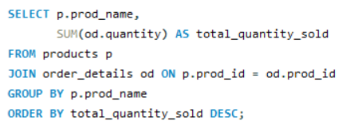
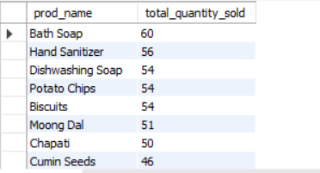
Product Performance
Products count per category
Highest total sales volume (by quantity)

Slide 13
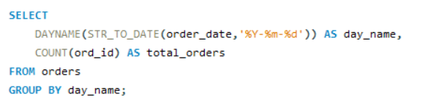

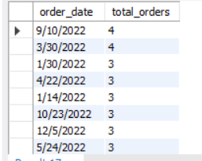
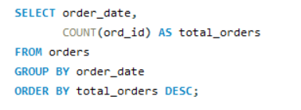
Sales & Order Trends
Weekday vs Weekend analysis
Dates with most orders

Slide 14
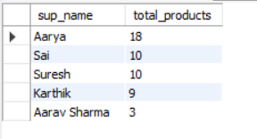
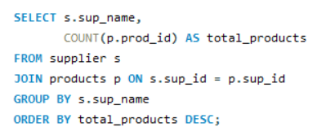
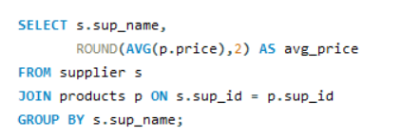
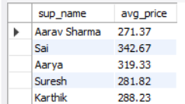
Supplier Contribution
Which supplier provides the most products?
What is the average price of products from each supplier?

Slide 15
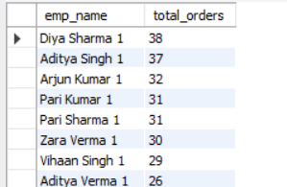
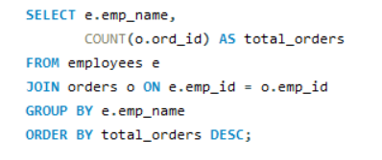
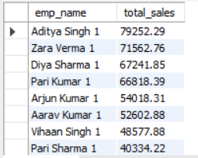
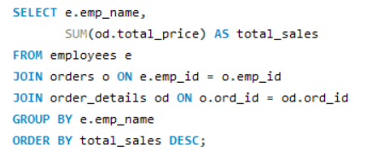
Employee Performance
Which employees have handled the most orders?
What is the Total order value handled per employee?

Slide 16
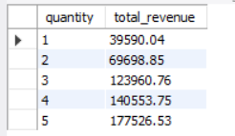
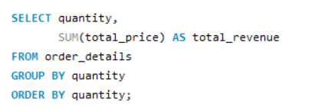
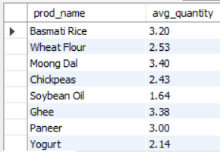
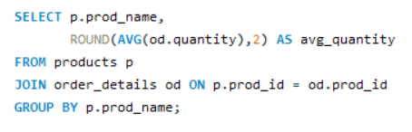
Order Details Deep Dive
Quantity vs Total Price relationship
Average quantity per product

Slide 17

Insights
A small group of customers contributes significantly to total revenue (high-value customers identified).
Certain products and categories generate higher sales and revenue compared to others.
Sales trends show variation across different dates and months, indicating peak sales periods.
Some suppliers contribute more to overall revenue due to high-performing products.
Employee performance varies based on number of orders handled and total sales processed.

Slide 18
Recommendations
Focus on retaining high-value customers through loyalty programs and targeted promotions.
Increase stock availability for best-selling products to avoid stockouts.
Improve marketing strategies during low-sales periods to balance revenue trends.
Strengthen partnerships with high-performing suppliers.
Provide training or incentives to improve employee performance and productivity.
Regularly monitor sales and inventory data to support proactive decision-making

Slide 19
Conclusion
The SQL-based Grocery Store Management System successfully organizes and manages store data using a structured relational database.
The system enables efficient tracking of customers, products, suppliers, employees, and orders.
Through SQL queries and data analysis, meaningful business insights were generated regarding sales performance, customer behavior, and product demand.
The project demonstrates how database systems can improve operational efficiency and support data-driven decision-making in retail businesses.

Slide 20


Slide 21



THANK YOU

